Slide 1
Joe Spencer
ME EN 497R research presentation

Slide 2
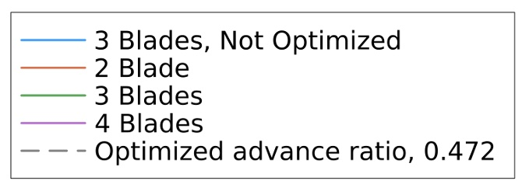
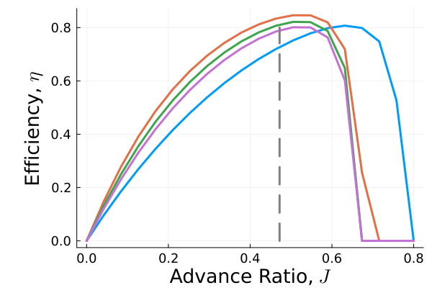
First Design

Slide 3
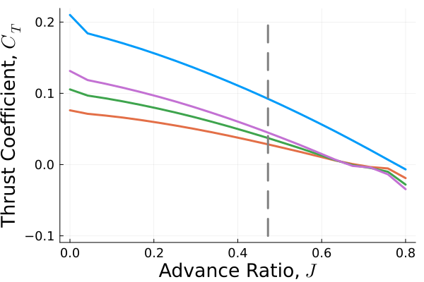

First Design

Slide 4

Problems

Slide 5

Problems

Slide 6
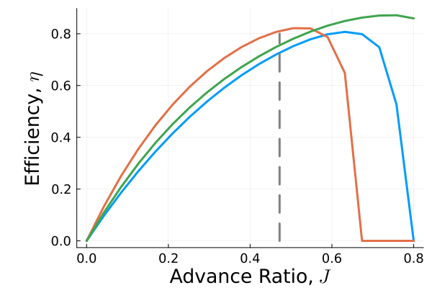

Second Design

Slide 7
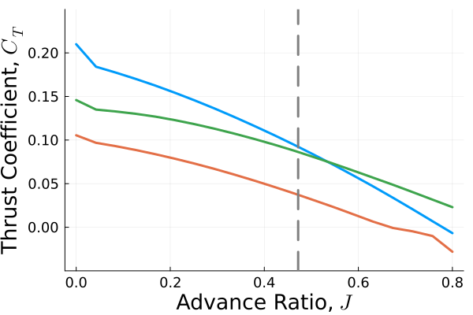

Second Design

